Slide 1
Personal
PORTFOLIO DESIGN
By
Joyce Vinoliya J
B.Sc(Computer Science)
Jawaharlal Nehru College for Women

Slide 2

1
Problem Statement
2
Project Overview
3
End Users
Agenda
4
Tools and Technologies
5
Portfolio Design and Layout
Topics Covered
6
Features and Functionality
7
Results and Screenshots
8
Conclusion

Slide 3
Problem Statement
In today’s digital age, many students and professionals lack a unified platform to present their academic achievements, projects, and technical skills. Traditional resumes often fail to capture creativity and interactivity. A personal portfolio website acts as a professional showcase, enabling individuals to present their talents in an elegant, accessible, and modern way."

Slide 4
Project Overview
About Me – Brief introduction, academic background, and goals.
Projects – Highlighted works with descriptions.
Skills – Technical & professional skills (visual progress bars).
Contact Information – Email

Slide 5
End Users
1. Students – Showcase academic work & projects for seminars and placements.
2. Job Seekers – Highlight professional skills and achievements for recruiters.
3. Freelancers – Build credibility & attract potential clients.

Slide 6

Frontend : HTML, CSS, JavaScript (core for structure, style, and interactivity).
Backend : PHP / Node.js (for contact form processing).
Database : MySQL (for storing contact form data).
IDE : Visual Studio Code (lightweight, developer- friendly).
Tools & Technologies

Slide 7








Header
Profile Section
Portfolio Design
& Layout
Name + Navigation Menu.
Decorative shape (no photo / placeholder only).
Skills Section
Projects Section & Contact Section
Circular progress bars with percentages.
Card-based design with hover effects & Form with validation + styled icons.

Slide 8
Responsive Design: Works seamlessly on mobile & desktop.
Modern UI/UX: Clean typography, chocolate + sandal color palette.
Navigation Bar: Smooth scrolling and active highlights.
Contact Form: Email validation & structured input.
Scalability: Easy to add new projects or update details.
Features & Functionality

Slide 9
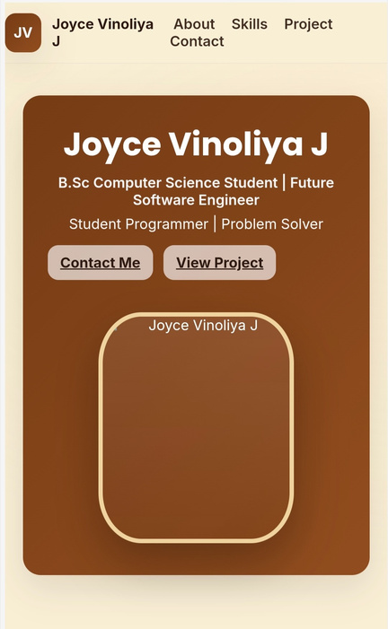
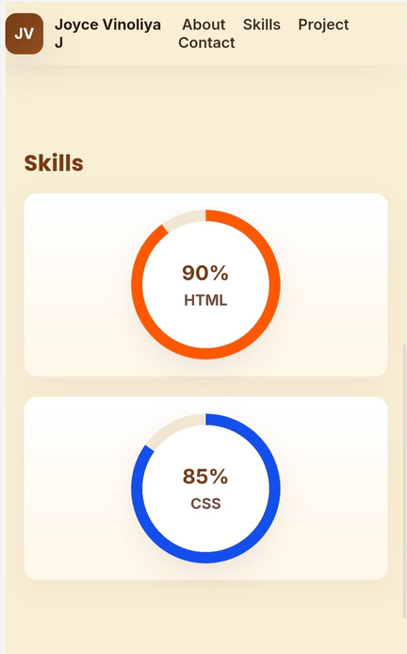
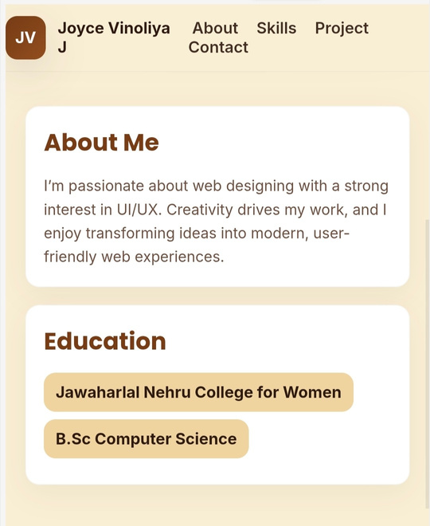
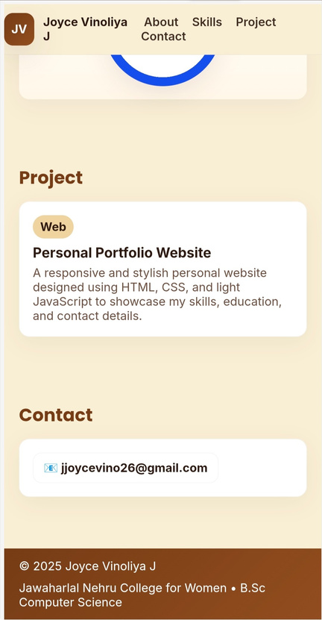
Results
& Screenshots

Slide 10

Conclusion
Portfolio websites have become an essential digital identity for students and professionals. Through this project, I gained hands-on experience in web development, responsive design, and user interface principles. This mini-project not only enhanced my technical skills but also taught me the importance of presentation and self-branding in today’s competitive world.

Slide 11
Thank you!

